Slide 1
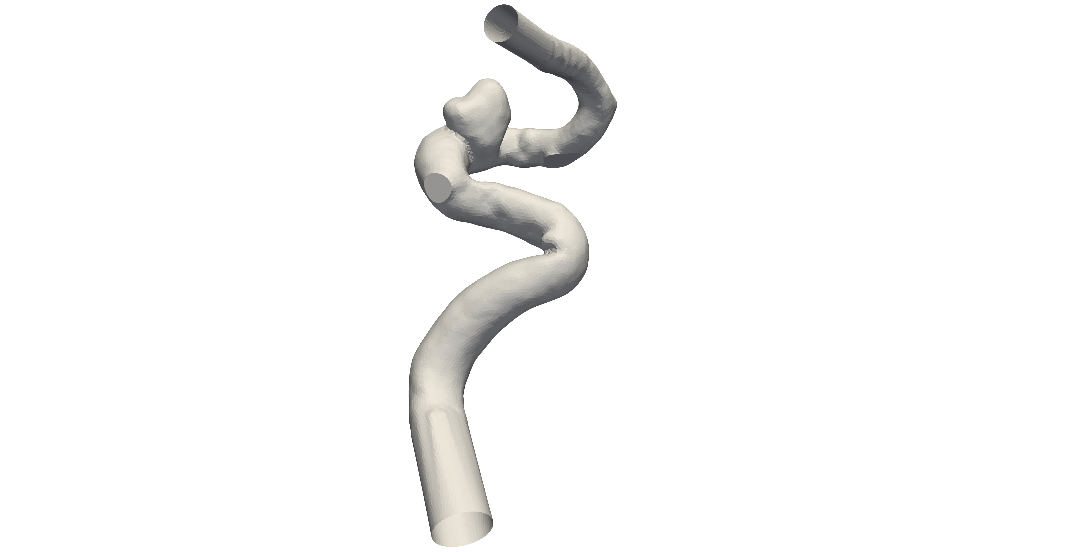
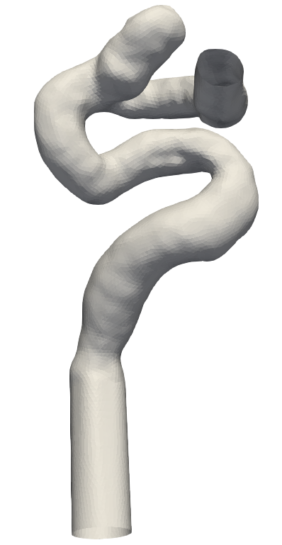
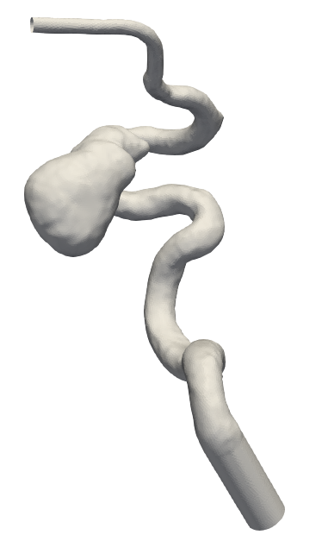
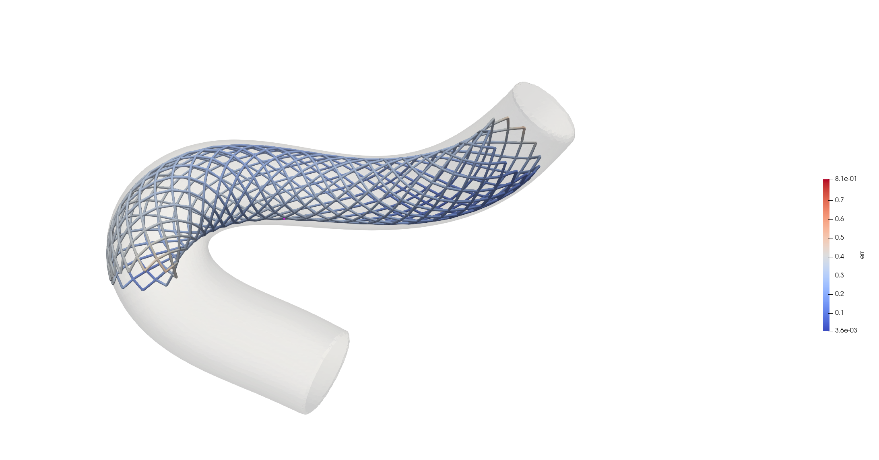
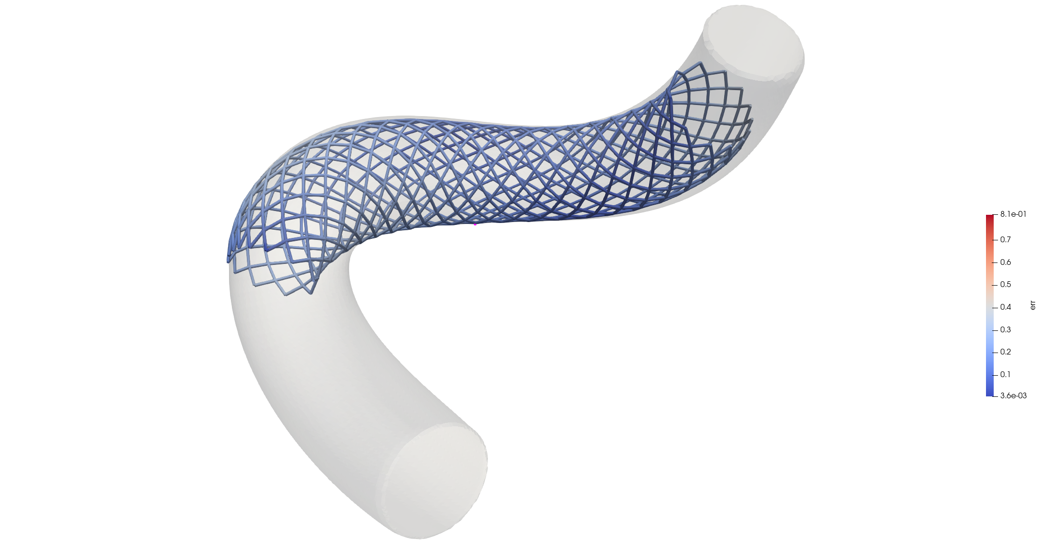
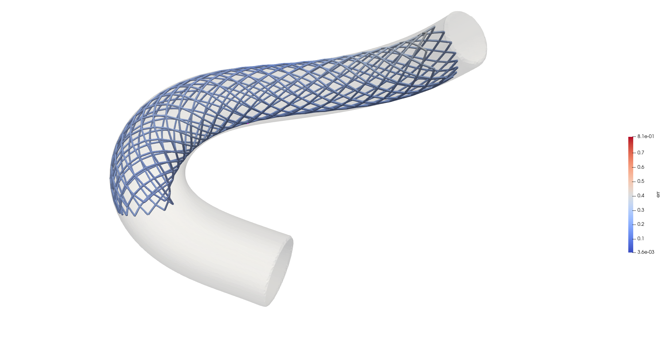

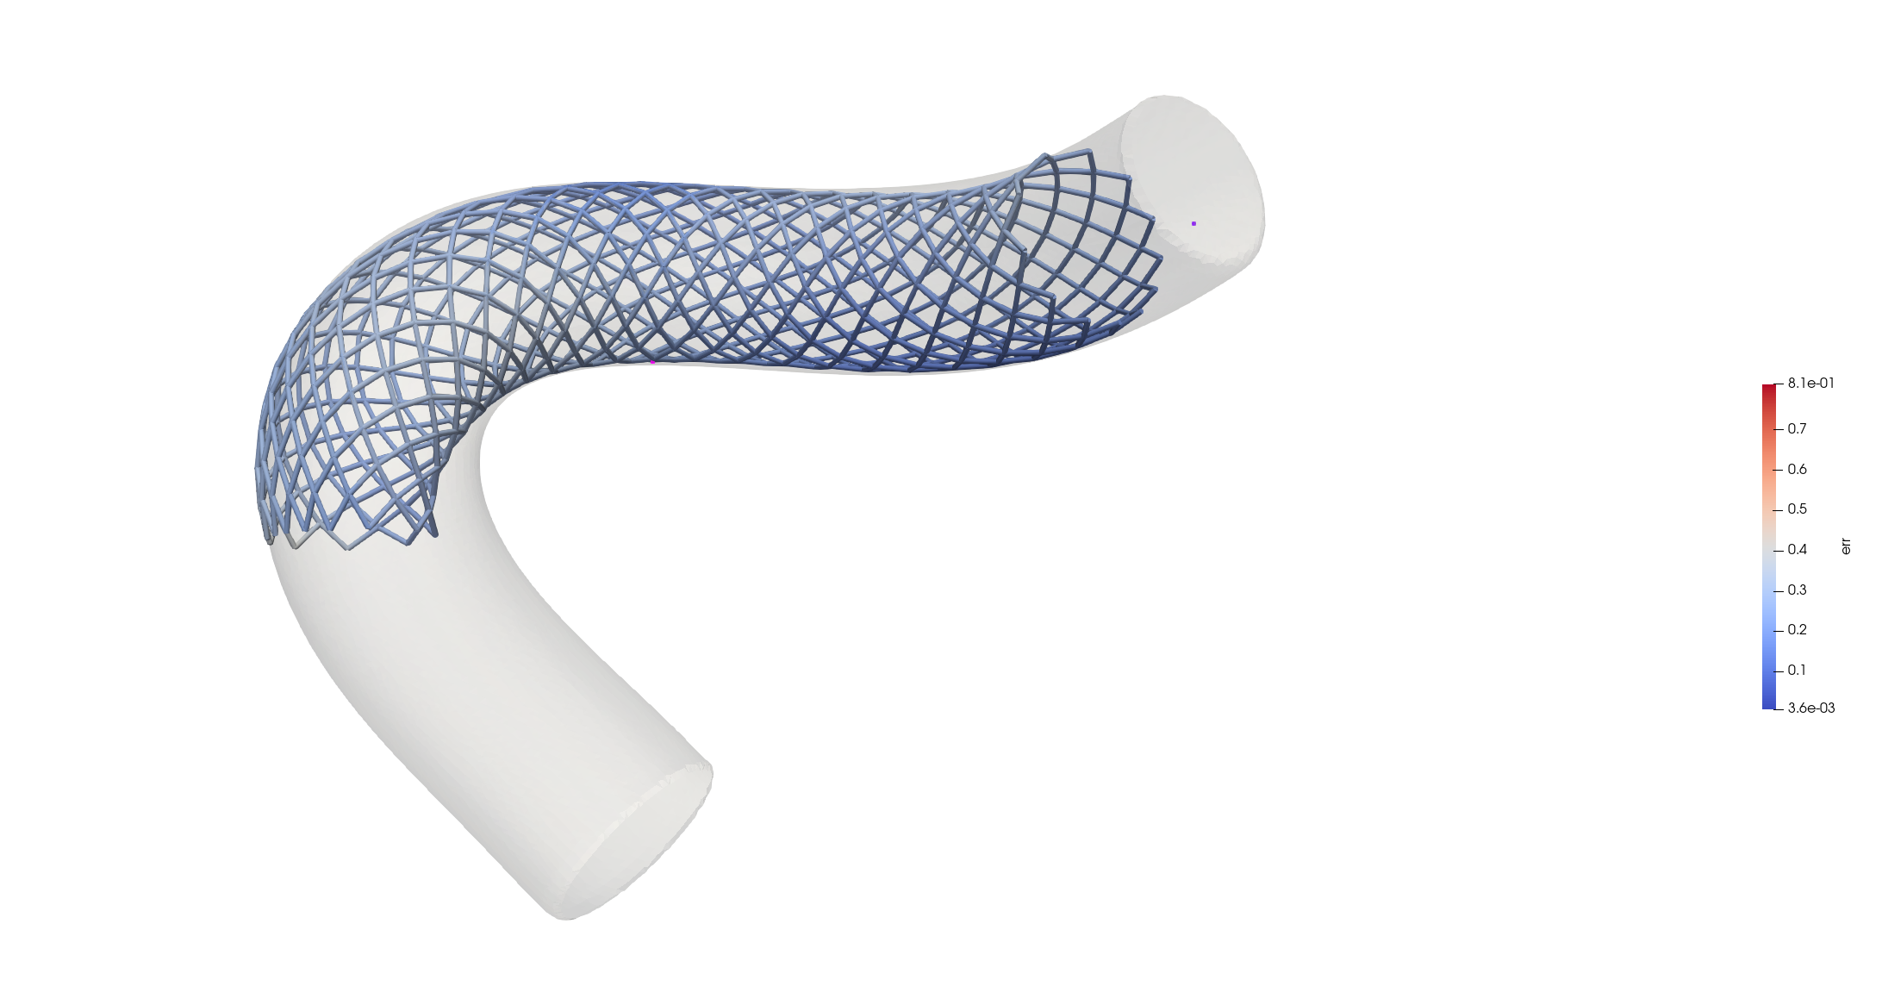
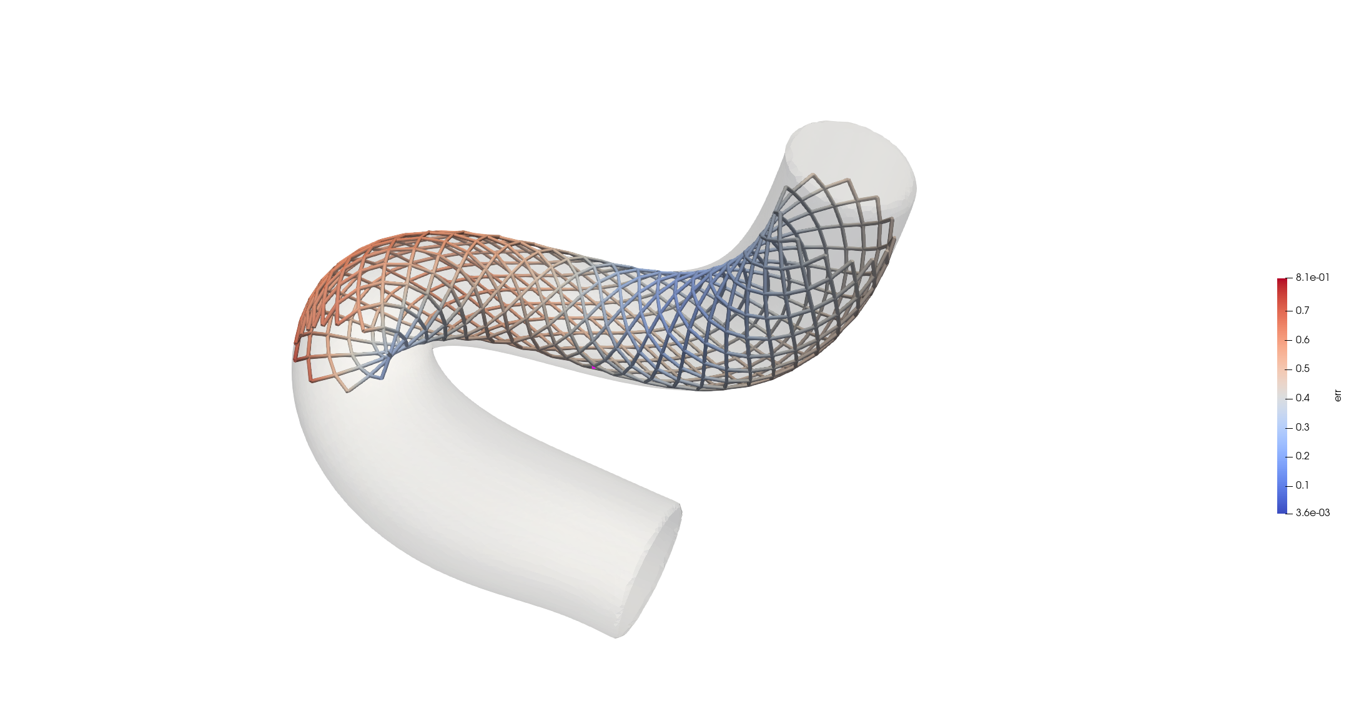
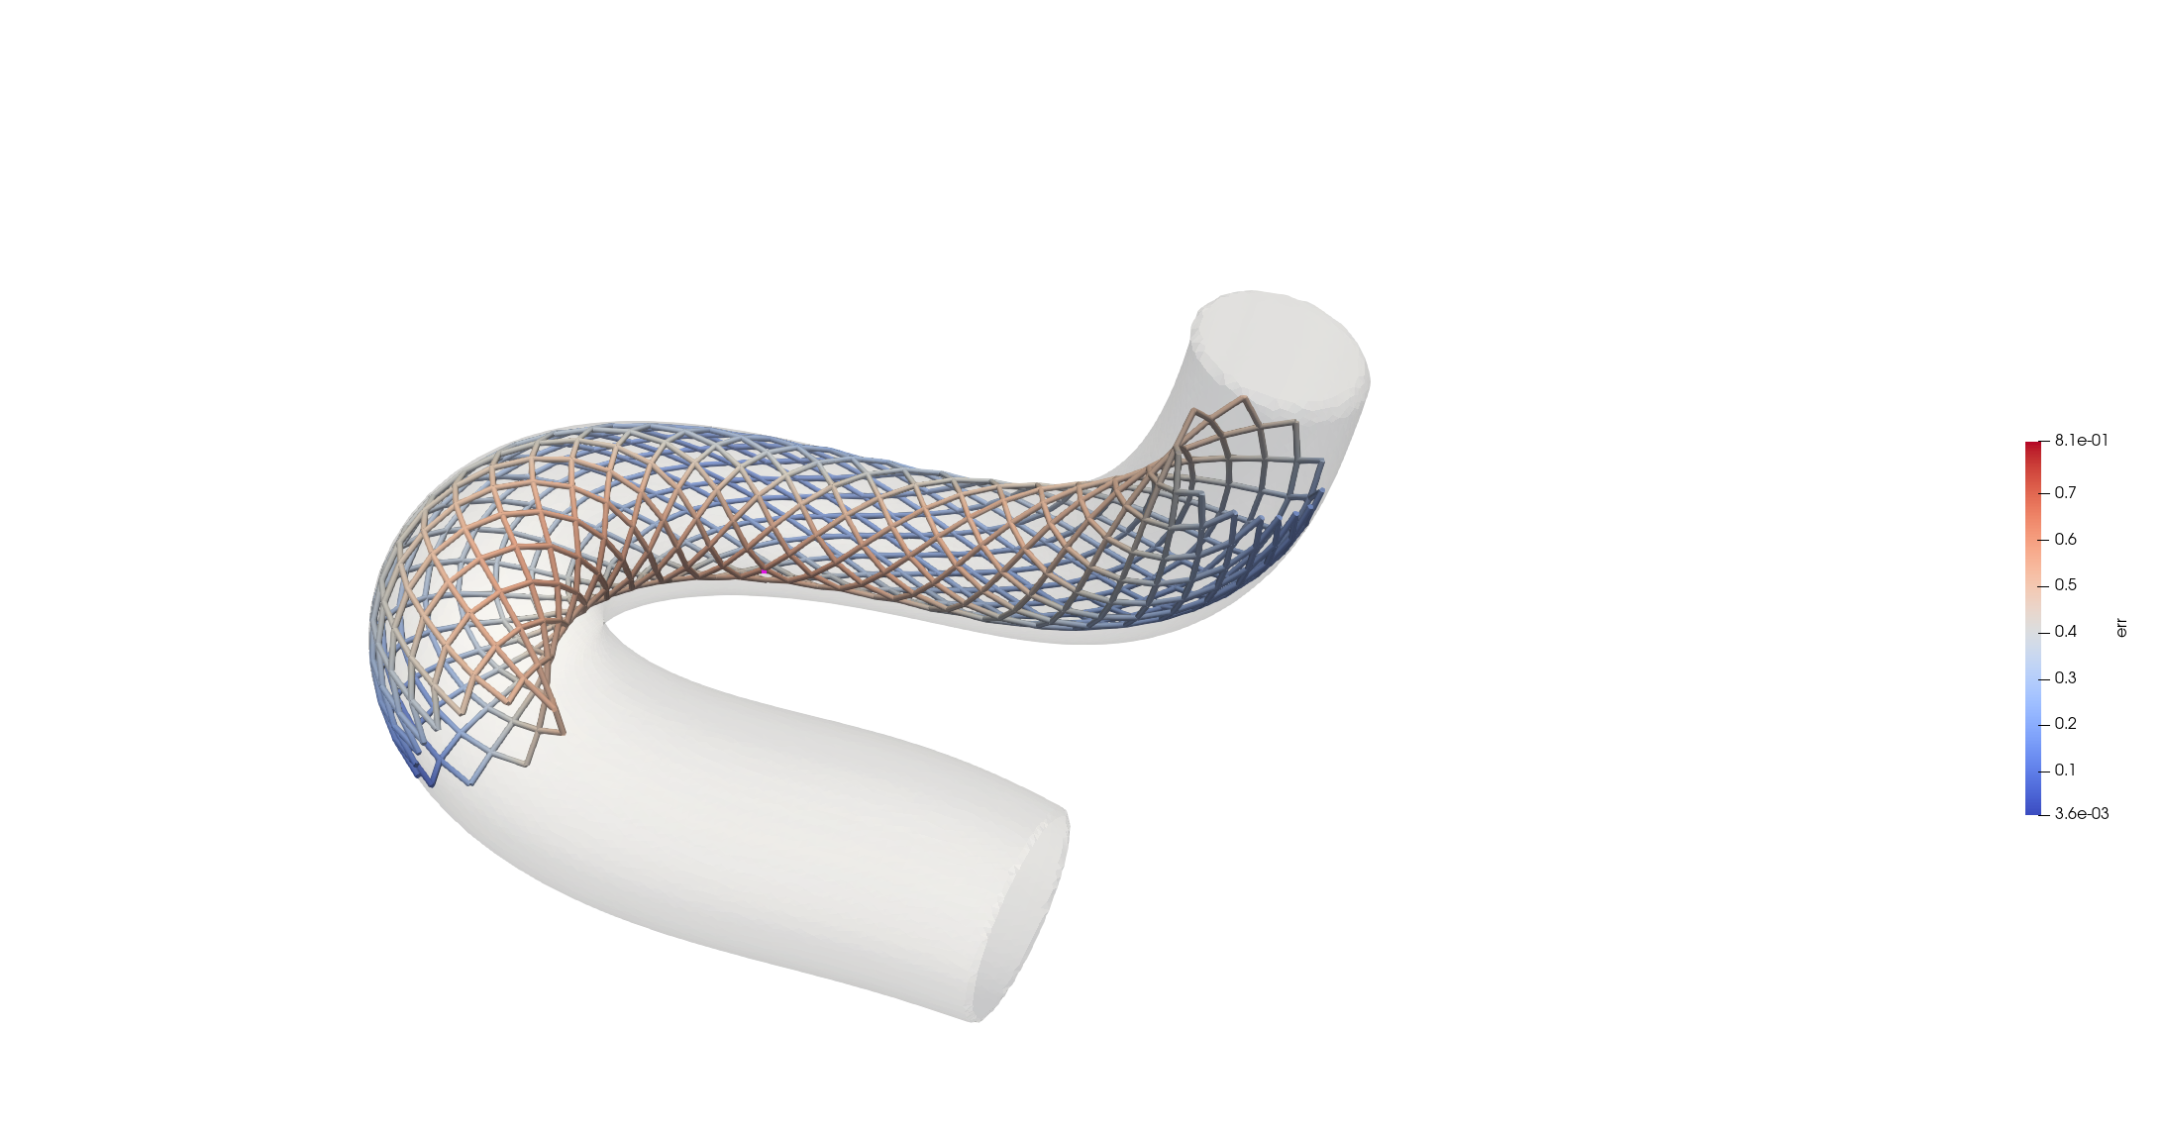

Slide 2
Outline
Challenges in biomechanics
Why reduced order modelling
Definition of the problem
Sampling
Building a reduced order model
Testing a reduced order model
Link between reduced order models and statistical shape models
Application to real biomechanical case

Slide 3


Challenges in Biomechanics
High-fidelity simulation in biomechanics
Computational models that accurately represent the physical, anatomical, and physiological properties of biological systems with high precision.
These models requires advanced numerical techniques to be solved,
e.g. finite element method (FEM).
High computational costs:
Complex, high-fidelity simulations can take hours or days to be computed.
Why?
Fine meshes, small time steps, nonlinear solver.

Slide 4
Challenges in Biomechanics
1. Complex Geometry:
Biological structures have irregular and highly detailed shapes. Meshing these geometries requires fine discretization.
2. Material Properties:
Biological materials are often nonlinear, anisotropic, and heterogeneous.
3. Multiscale Nature:
Biomechanics involves processes at multiple scales.
Macroscopic: Whole-body dynamics.
Microscopic: Cellular or molecular interactions.
4. Coupled Physics:
Many simulations need to account for multiple interacting physical phenomena.
Fluid-structure interaction: Electromechanical coupling.
5. Patient-Specific Modeling
Personalized simulations based on medical imaging require customization of the model for each patient.
6. Time-Dependent Simulations
Many biomechanics problems are dynamic and require transient analysis (e.g., simulating gait cycles, cardiac cycles).
7. Solver Complexity
For nonlinear problems (e.g., large deformations in soft tissues/contact interactions), solvers must iterate until convergence, which can take many iterations. Large matrices with millions of degrees of freedom require significant memory and computation.

Slide 5

Challenges in Biomechanics
MULTI-QUERY SIMULATION DEMANDS
Solving the same complex model repeatedly for varying geometries and material properties or exploring multiple clinical scenarios is computationally expensive.
Example: Optimize prosthesis design to patient-specific properties.
REAL-TIME SIMULATION DEMANDS
Applications such as surgical planning or diagnostics require immediate results.
Example: Predicting the deformation of tissues during robotic-assisted surgery.

Slide 6
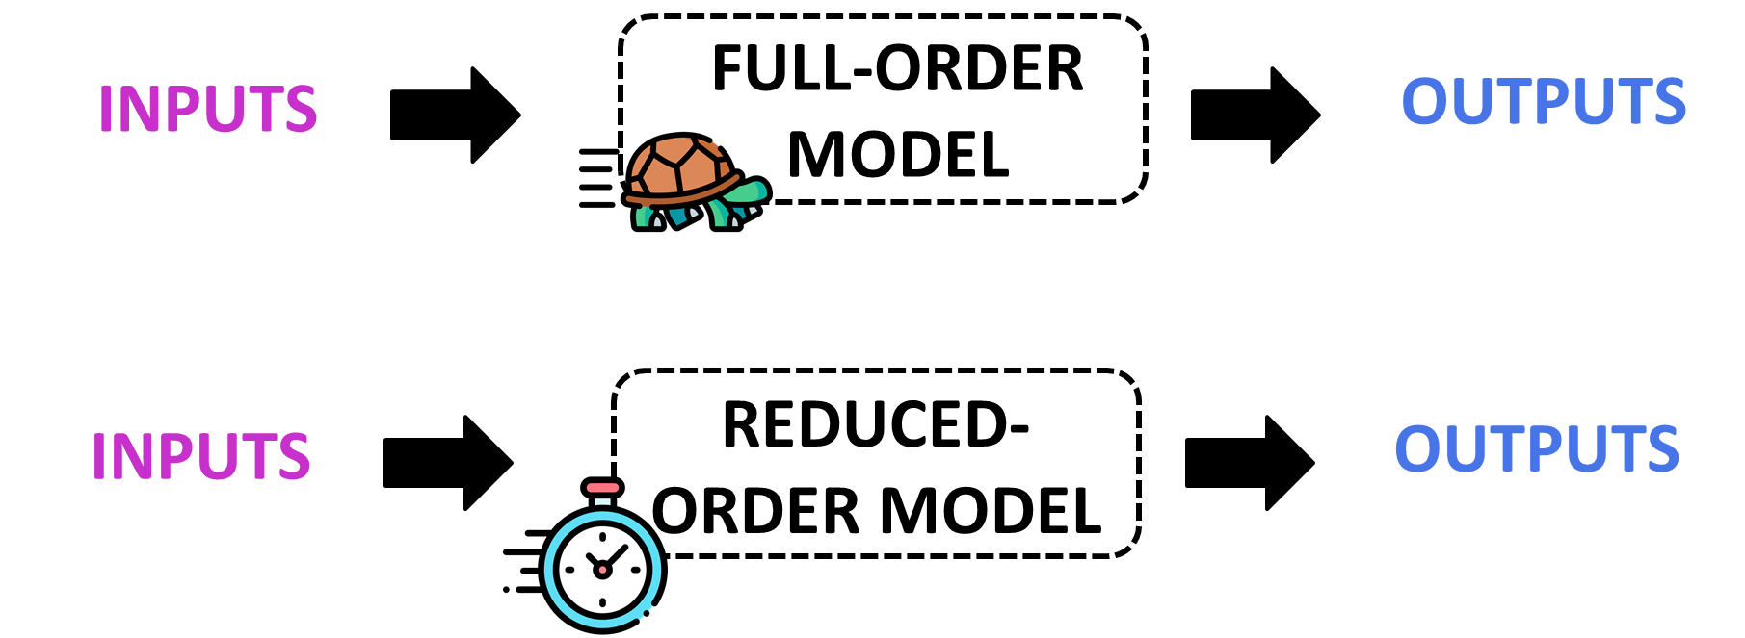
Why Reduced-Order Modeling?
Reduced-Order Modeling (ROM) is a computational approach aimed at simplifying complex, high-fidelity models by constructing a lower-dimensional representation of the original problem.
Purpose: Balance between computational speed and accuracy of results.

Slide 7
Two Examples of the Application in Biomechanics
Example: Optimize prosthesis design to patient-specific properties.
Personalized Fit: ROMs can quickly simulate how variations in prosthesis geometry or material properties affect performance, ensuring an optimal fit for an individual’s unique anatomy.
Accelerated Product Development: ROMs enable rapid testing and optimization of prosthetic components, reducing the need for time-intensive, full-order simulations.
Example: Predicting the deformation of tissues during robotic-assisted surgery.
Real-Time Simulation: Enables surgeons to see real-time predictions of how tissues will deform under applied forces, improving surgical accuracy.
Training and Planning: ROMs can also be used preoperatively to simulate different surgical scenarios and train surgeons on patient-specific models.

Slide 8
Family of ROM: Two Main Approaches
Intrusive ROM
Non-Intrusive ROM
Directly modifies the governing equations of the high-fidelity model to create a reduced system.
Builds a surrogate model or approximation without directly modifying the original equations.
Requires access to and modification of the original mathematical model (e.g., FEM formulation).
Treats the original model as a black box.
Use a data-driven approach to learn a mapping between inputs and outputs.

Slide 9

Family of ROM: Two Main Approaches
Feature | Intrusive | Non-Intrusive (Extrusive)
Model Access | Requires full access | Black-box
Implementation | Complex | Easier
Accuracy | Typically higher | Dependent on training data
Flexibility | Low | High
Topic of the class: Non-intrusive reduced order modelling.
Key words: Surrogate modelling, data-driven approach, regression, machine learning.

Slide 10


HIGH-FIDELITY MODEL
INPUTS
OUTPUTS
SURROGATE MODEL
INPUTS
OUTPUTS
Uses data-driven approaches (machine learning) to approximate input-output relationships.

Slide 11
Offline vs Online
Offline Stage:
The surrogate model is built/trained using pre-generated data from high-fidelity simulations.
Online Stage:
The trained surrogate model is used to make fast predictions (extrapolation) for new inputs.
This step is computationally intensive but allows for efficient evaluation during the online stage.

Slide 12




[Offline] Preprocessing
Define the high-fidelity model: Clearly establish the high-fidelity model that serves as the baseline for generating training data.
INPUTS
GOVERNING EQUATIONS
OUTPUT
GEOMETRY: $g$
MATERIAL: $m$
SIMULATION RESULT: QUANTITIES OF INTEREST
FEM/CFD/FSI
BCs: $b$
e.g., displacement, pressure, velocity, …
LOADS: $f$

Slide 13

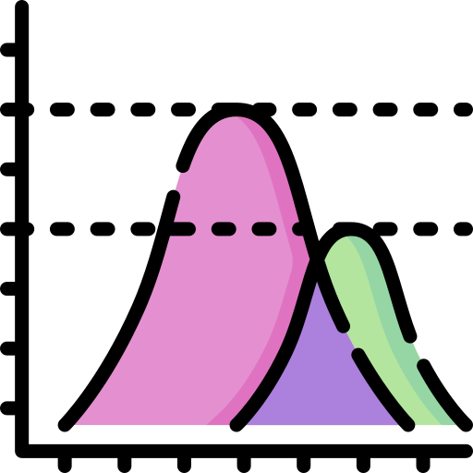


[Offline] Preprocessing
z
Define the high-fidelity model: Clearly establish the high-fidelity model that serves as the baseline for generating training data.
INPUTS
GOVERNING EQUATIONS
OUTPUT
How to parametrize a geometry?
GEOMETRY: $g$
GEOMETRY: $g$
MATERIAL: $m$
SIMULATION RESULT: QUANTITIES OF INTEREST
FEM
BCs: $b$
Geometrical approach
Geometrical approach
Statistical approach
LOADs: $f$

Slide 14




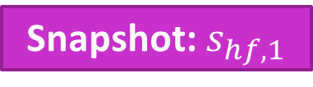

[Offline] Preprocessing
Generate Data: Run high-fidelity simulations for various combinations of input parameters.
INPUTS
GOVERNING EQUATIONS
OUTPUT
$${\left\{g,m,b,f\right\}}_{1}$$
Snapshot: $s_{hf,1}$
$${\left\{g,m,b,f\right\}}_{2}$$
$$s_{hf,2}$$
FEM/CFD/FSI
…
…
$${\left\{g,m,b,f\right\}}_{N_{S}}$$
$$s_{{hf,N}_{S}}$$

Slide 15










Offline: Preprocessing
2
Generate Data: Run high-fidelity simulations for various combinations of input parameters.
INPUTS
GOVERNING EQUATIONS
OUTPUT
How to choose these inputs?
$${\left\{g,m,b,f\right\}}_{1}$$
$${\left\{g,m,b,f\right\}}_{1}$$
Snapshot: $s_{1}$
$${\left\{g,m,b,f\right\}}_{2}$$
$${\left\{g,m,b,f\right\}}_{2}$$
$$s_{2}$$
FEM
…
Geometrical approach
…
Sampling
…
$${\left\{g,m,b,f\right\}}_{N_{S}}$$
$${\left\{g,m,b,f\right\}}_{M}$$
$$s_{M}$$

Slide 16
[Offline] Sampling
Why Sampling Matters?
The quality of the surrogate model heavily depends on the representativeness of the training data.
Efficient sampling ensures:
Adequate coverage of the parameter space.
Reduced computational cost by minimizing unnecessary high-fidelity simulations.
Accurate predictions for unseen data.
Balancing exploration and exploitation.
To ensure the surrogate model captures the global behavior of the system across the entire parameter space.
To refine the surrogate model in regions where the system response is complex or where high accuracy is required.

Slide 17
[Offline] Common Sampling Techniques
Parameter 2
Parameter 1
Grid Sampling
Random Sampling
Latin Hypercube Sampling
Divides the parameter space into strata and samples from each stratum.
Divides the parameter space into a uniform grid.
Selects points randomly in the parameter space.

Slide 18

[Offline] Common Sampling Techniques
Grid Sampling
Advantages: Simple and systematic.
Disadvantages: Computationally expensive in high-dimensional spaces due to the curse of dimensionality.
As the number of dimensions increases, the amount of data required to represent or sample the space effectively grows exponentially.
Random Sampling
Advantages: Easy to implement, avoids bias.
Disadvantages: May leave gaps or clumps in the parameter space.
Latin Hypercube Sampling (LHS)
Advantages: Ensures uniform coverage.
Disadvantages: May not be optimal for complex parameter distributions.

Slide 19
[Offline] More Advanced Sampling Techniques
These techniques only focus on exploration: how to take into account exploitation?
Adaptive Sampling
1) First sampling (e.g., LHS).
2) Compute high-fidelity solutions for each of these points.
3) Build the surrogate model considering these points.
4) Compute the error between high-fidelity and predicted solutions.
5) Interpolate the error on the parameters space.
6) Add new point in correspondence with the maximum error.

Slide 20
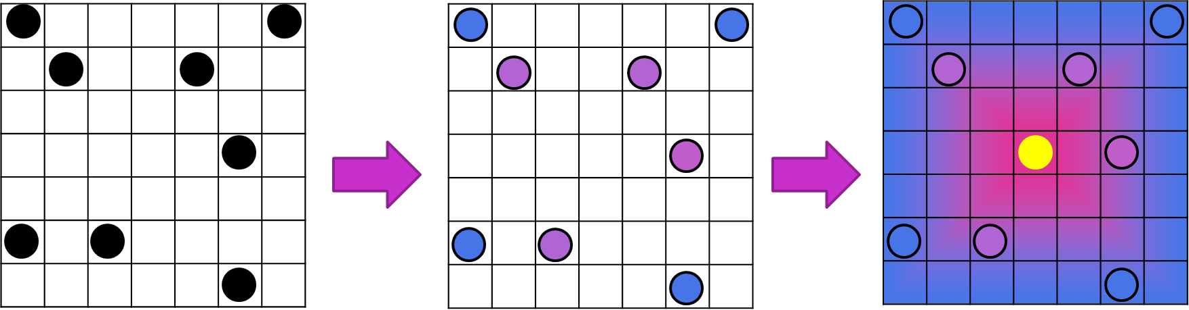
[Offline] More Advanced Sampling Techniques
Adaptive Sampling
Repeat until the global error reaches the desired value.
Advantages
Reduces the total number of high-fidelity simulations required.
Improves surrogate model performance in critical regions of the parameter space.
Adapts to system behavior and can be tailored for specific problems.
Challenges
Each iteration requires training and evaluating the model.
Requires careful design of criteria to guide sampling.
Poor initial coverage may bias the sampling process.

Slide 21
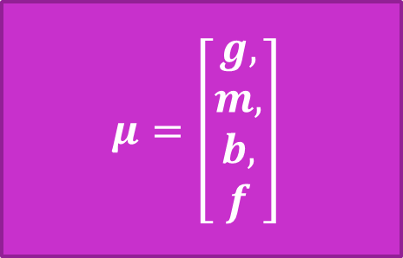
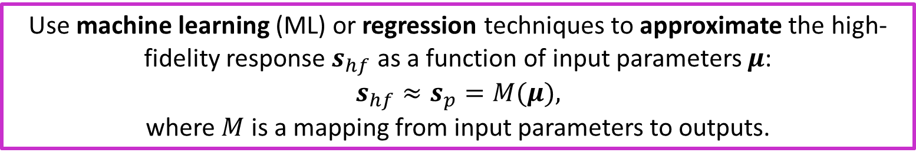
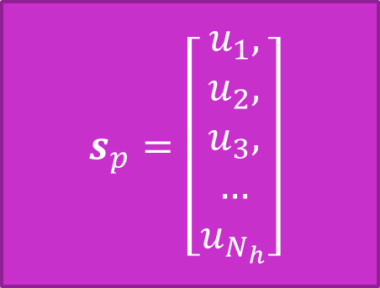

[Offline] Build Surrogate Model
INPUTS
OUTPUT
$$s_{p}=\left[\begin{aligned}u_{1}, \\ u_{2}, \\ u_{3}, \\ … \\ u_{N_{h}}\end{aligned}\right]$$
$$μ=\left[\begin{aligned}g, \\ m, \\ b, \\ f\end{aligned}\right]$$
SURROGATE MODEL: $M$
Parameters
Snapshot
Use machine learning (ML) or regression techniques to approximate the high-fidelity response $s_{hf}$ as a function of input parameters $μ$:
$$s_{hf}≈s_{p}​=M(μ),$$
where $M$ is a mapping from input parameters to outputs.

Slide 22


[Offline] Build Surrogate Model
The output in reduced-order modeling is typically a continuous variable; therefore, we use regression models. For discrete variables, we would refer to classification models.
Classify whether a subject has a gait abnormality due to a specific condition or a normal gait pattern.
Predict the magnitude of forces acting on a joint during specific activities (e.g., walking, running, or jumping).
MACHINE LEARNING
Classification and regression are two fundamental tasks in supervised machine learning.
SUPERVISED
UNSUPERVISED
Supervised learning involves training a model on labeled data, where the outcomes or targets are known.

Slide 23
[Offline] Common Regression/ML Models for ROM
Polynomial Regression
Fits a polynomial function to approximate the response.
Suitable for simple, low-dimensional systems.
Gaussian Process Regression (GPR)
Assumes that the data is drawn from a multivariate Gaussian distribution.
Ideal for small dataset, provides predictions with uncertainty estimates.
Artificial Neural Networks (ANNs)
Consist of interconnected layers of nodes (neurons) that process data by applying weights, biases, and activation functions
Flexible and powerful for complex, nonlinear systems.
Requires larger training datasets to avoid overfitting.

Slide 24
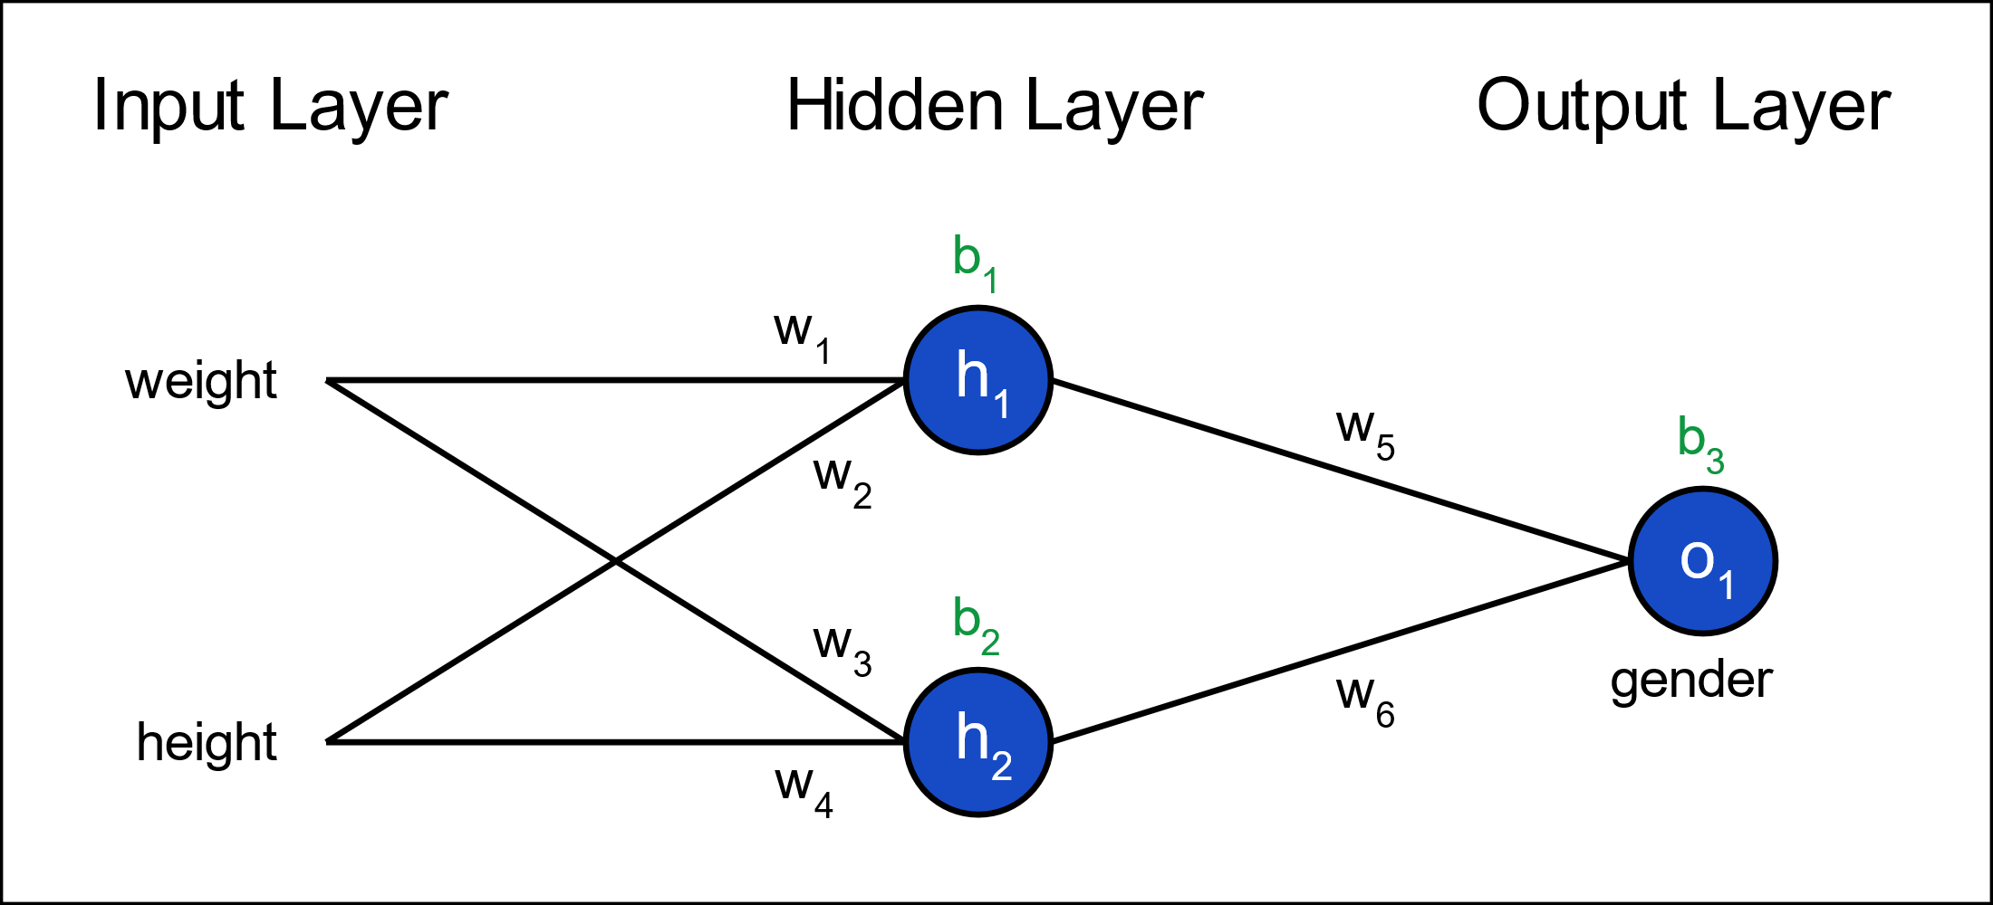
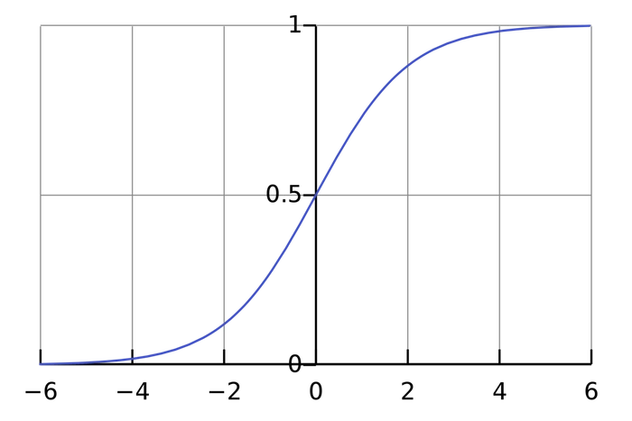
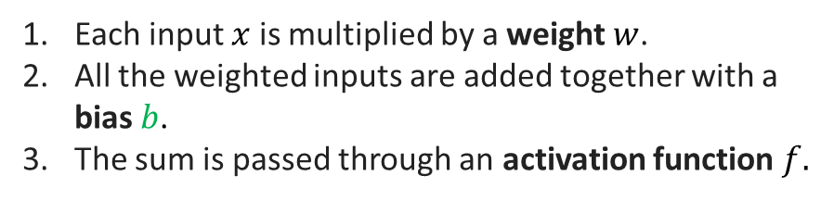

[Offline] Common Regression/ML Models for ROM
Artificial Neural Networks (ANNs)
$$h_{1}=f\left(w_{1}x_{1}+w_{2}x_{2}+b_{1}\right)$$
Parameter 1
Each input $x$ is multiplied by a weight $w$.
All the weighted inputs are added together with a bias $b$.
The sum is passed through an activation function $f.$
$$x_{1}$$
Parameter 2
Snapshot
$$x_{2}$$
The activation function is used to turn an unbounded input into an output that has a predictable form.
A commonly used activation function is the sigmoid function:

Slide 25
[Offline] Model Training
Fitting the ML model: Find the best combination of model parameters to minimize the difference between the model's predictions and the actual data.
Model parameters are the internal variables that the model adjusts to best fit the data.
e.g . for ANNs : weights and biases of connections between layers.
Hyperparameters define how this optimization occurs.
e.g. for ANNs: activation functions, number of neurons per layer, number of layers.

Slide 26
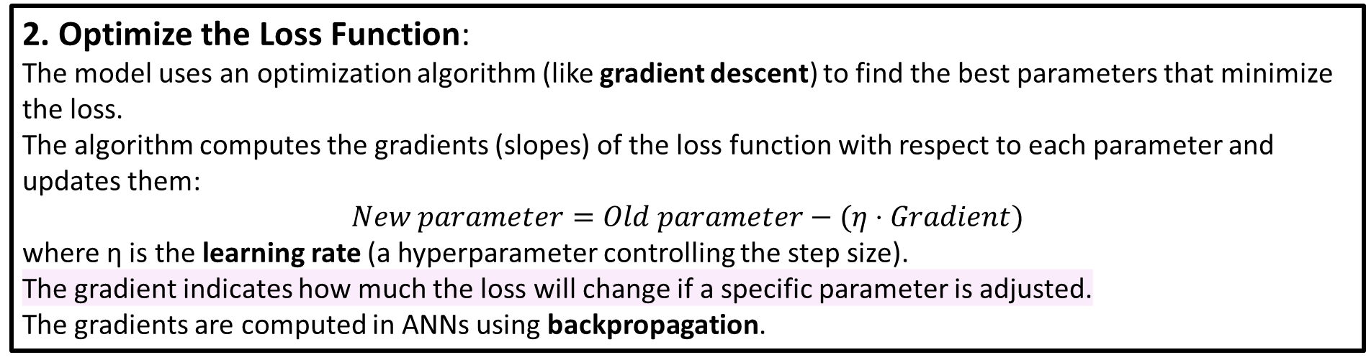
[Offline] Model Training
How Are These Parameters Learned?
1. Define a Loss Function:
The loss function measures how far off the model's predictions are from the true values.
2. Optimize the Loss Function:
The model uses an optimization algorithm (like gradient descent) to find the best parameters that minimize the loss.
The algorithm computes the gradients (slopes) of the loss function with respect to each parameter and updates them:
$$New parameter=Old parameter−(η⋅Gradient)$$
where η is the learning rate (a hyperparameter controlling the step size).
The gradient indicates how much the loss will change if a specific parameter is adjusted.
The gradients are computed in ANNs using backpropagation.

Slide 27
[Offline] Model Training
What Changes in the Model?
OFFLINE
At the start of training:
Parameters are initialized randomly or with some heuristic.
The model makes predictions that are likely very inaccurate.
During training:
The parameters are updated iteratively to minimize the loss function.
Gradually, the model learns to better approximate the relationship between inputs and outputs.
At the end of training:
The optimized parameters define how the model processes input data to make accurate predictions.
ONLINE

Slide 28
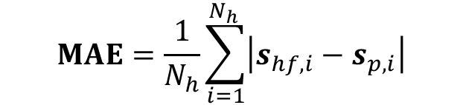
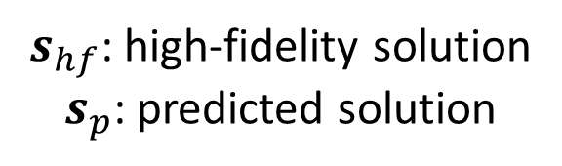
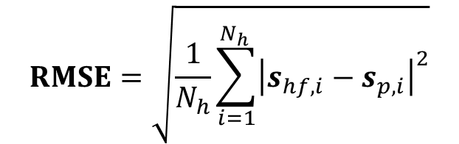
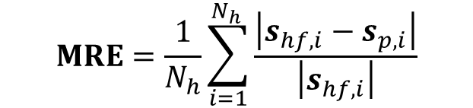
[Online] Model Testing
Model Testing: Evaluate the model on unseen data to check for generalization by computing the prediction error (distance between predicted and high fidelity data).
$s_{hf}$: high-fidelity solution
$s_{p}$: predicted solution
MEAN ABSOLUTE ERROR
MEAN RELATIVE ERROR
ROOT MEAN SQUARED ERROR
$$RMSE=\sqrt{\frac{1}{N_{h}}\sum_{i=1}^{N_{h }}{{\left|s_{hf,i}−s_{p,i}\right|}^{2}}}$$
$$MAE=\frac{1}{N_{h}}\sum_{i=1}^{N_{h }}{\left|s_{hf,i}−s_{p,i}\right|}$$
$$MRE=\frac{1}{N_{h}}\sum_{i=1}^{N_{h }}{\frac{\left|s_{hf,i}−s_{p,i}\right|}{\left|s_{hf,i}\right|}}$$
Measures the average absolute difference between the ROM predictions and the high-fidelity solutions.
Normalizes the error relative to the reference value to assess the proportion of error.
Computes the square root of the average squared differences, giving greater weight to larger errors.

Slide 29
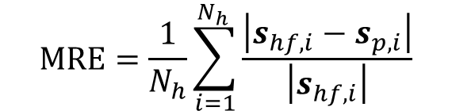
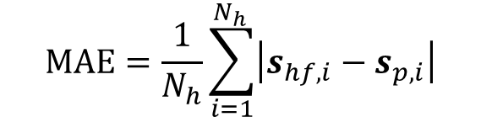
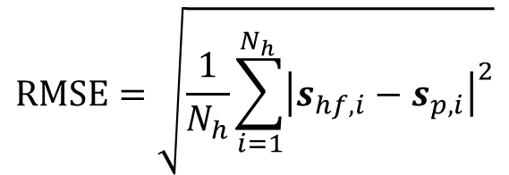
[Online] Model Testing
Typically, we will split the high-fidelity database in two subsets: one for training, one for testing.
For each testing case, we compute:
CASE-SPECIFIC
MEAN ABSOLUTE ERROR
MEAN RELATIVE ERROR
ROOT MEAN SQUARED ERROR
$$RMSE=\sqrt{\frac{1}{N_{h}}\sum_{i=1}^{N_{h }}{{\left|s_{hf,i}−s_{p,i}\right|}^{2}}}$$
$$MAE=\frac{1}{N_{h}}\sum_{i=1}^{N_{h }}{\left|s_{hf,i}−s_{p,i}\right|}$$
$$MRE=\frac{1}{N_{h}}\sum_{i=1}^{N_{h }}{\frac{\left|s_{hf,i}−s_{p,i}\right|}{\left|s_{hf,i}\right|}}$$
Then, we can compute metrics at the level of the testing subsets (mean, standard deviation,…)
DATABASE-LEVEL

Slide 30
Bridging the Gap: Linking SSMs and ROMs
Reduced order modeling and statistical shape modelling share some conceptual and methodological aspects.
1
Personalization
2
Dimensionality Reduction

Slide 31
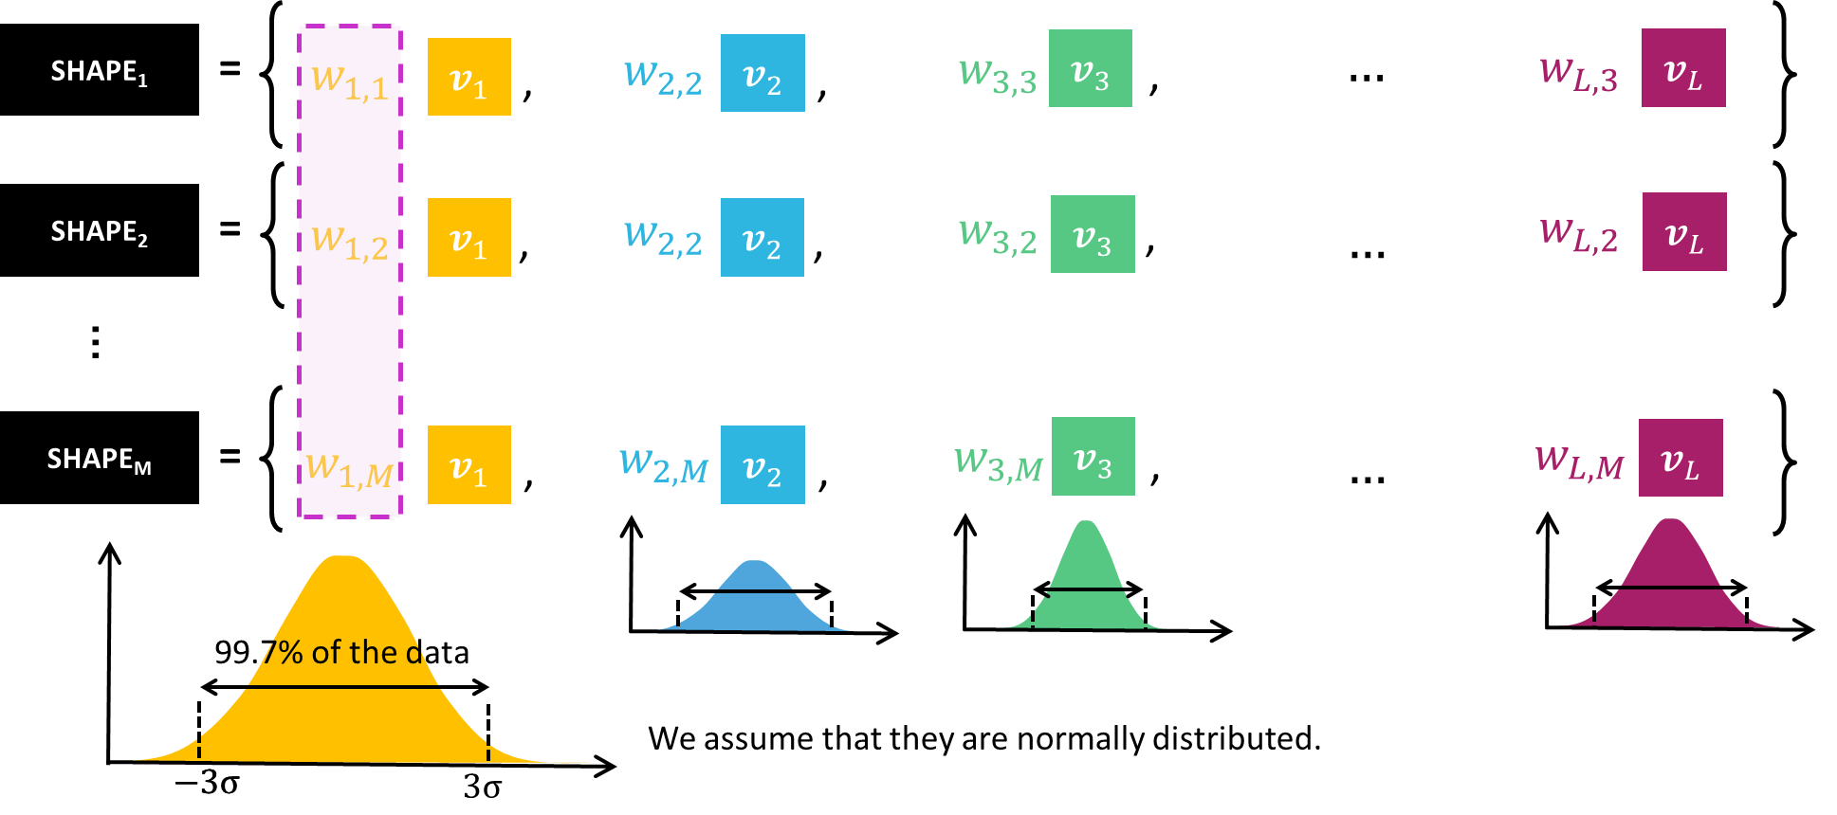
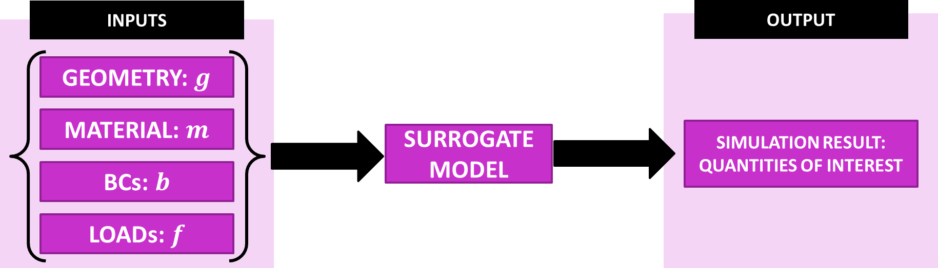

Personalization
SSM
SSMs allow for the generation of geometrically accurate but simplified representations of anatomical structures.
ROM
ROMs can incorporate the variability represented by SSMs to perform simulations that are personalized at a patient-specific level.
GEOMETRY: $g$
This is critical for application in surgical planning.

Slide 32
Dimensionality Reduction
2
Dimensionality Reduction
In biomechanics, the output of ROMs, represented by each snapshot, is typically a high-dimensional vector.
Compressing these outputs during the training phase is an effective strategy to accelerate and facilitate the computations during the training phase.
The same technique used to build SSMs can be used for this purpose: principal component analysis (PCA).
One shape
SSM
ROM
Principal component analysis (PCA)
Proper orthogonal decomposition (POD)
Shape
Snapshot
Principal components or modes
Reduced basis

Slide 33
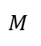
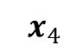
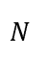
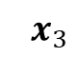
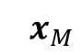
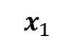
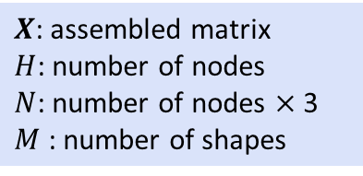
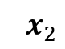
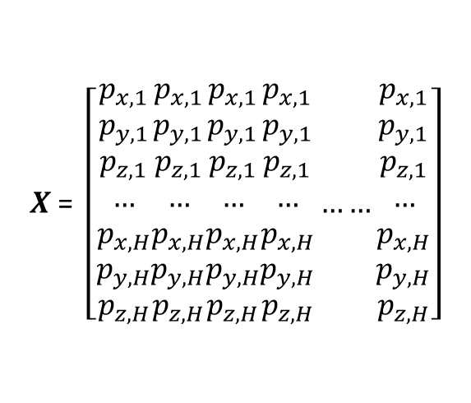
Dimensionality Reduction
$X \text{=} \left[\begin{aligned}p_{x,1} \\ p_{y,1} \\ p_{z,1} \\ … \\ p_{x,H} \\ p_{y,H} \\ p_{z,H}\end{aligned}\begin{aligned}p_{x,1} \\ p_{y,1} \\ p_{z,1} \\ … \\ p_{x,H} \\ p_{y,H} \\ p_{z,H}\end{aligned}\begin{aligned}p_{x,1} \\ p_{y,1} \\ p_{z,1} \\ … \\ p_{x,H} \\ p_{y,H} \\ p_{z,H}\end{aligned}\begin{aligned}p_{x,1} \\ p_{y,1} \\ p_{z,1} \\ … \\ p_{x,H} \\ p_{y,H} \\ p_{z,H}\end{aligned}……\begin{aligned}p_{x,1} \\ p_{y,1} \\ p_{z,1} \\ … \\ p_{x,H} \\ p_{y,H} \\ p_{z,H}\end{aligned}\right]$
$${ x}_{1}$$
$${ x}_{2}$$
$${ x}_{3}$$
$${ x}_{4}$$
$${ x}_{M}$$
$X$: assembled matrix
$H$: number of nodes
$N$: number of nodes $×$ 3
$M$ : number of shapes
$$N$$
$$M$$

Slide 34





Dimensionality Reduction
Key ideas of principal component analysis (PCA):
Identify the directions (principal components/modes) that capture the most variance Project data onto these axes to create a new (compressed) reppresentation (principal coefficients) .
EIGENVECTORS of $C$
PRINCIPAL COMPONENTS
of $X$
COVARIANCE MATRIX $C$ of $X$
EIGENVALUES of $C$
PRINCIPAL COEFFICIENTS
of $X$
PROJECTIONS ON EIGENVECTORS REFERENCE SYSTEM
Notes:
To identify the directions of maximum variance in the data, we compute the eigenvectors and eigenvalues of the covariance matrix. The eigenvectors represent the principal components (the new axes), and the eigenvalues indicate the amount of variance captured by each component.

Slide 35
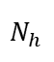
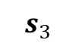
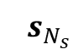
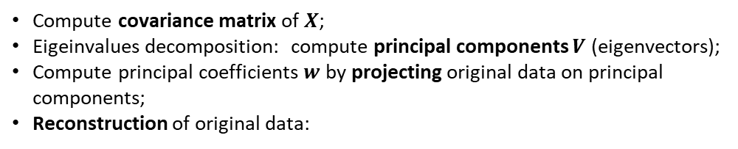
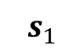
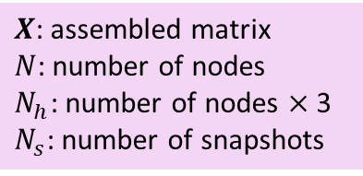
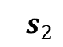
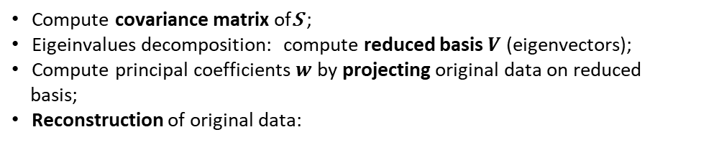
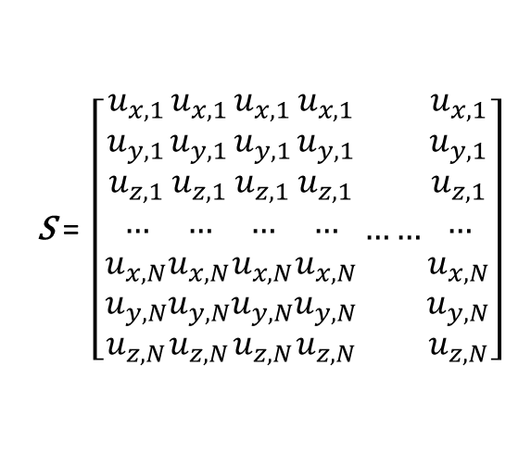
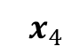
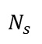
Dimensionality Reduction
$X \text{=} \left[\begin{aligned}p_{x,1} \\ p_{y,1} \\ p_{z,1} \\ … \\ p_{x,H} \\ p_{y,H} \\ p_{z,H}\end{aligned}\begin{aligned}p_{x,1} \\ p_{y,1} \\ p_{z,1} \\ … \\ p_{x,H} \\ p_{y,H} \\ p_{z,H}\end{aligned}\begin{aligned}p_{x,1} \\ p_{y,1} \\ p_{z,1} \\ … \\ p_{x,H} \\ p_{y,H} \\ p_{z,H}\end{aligned}\begin{aligned}p_{x,1} \\ p_{y,1} \\ p_{z,1} \\ … \\ p_{x,H} \\ p_{y,H} \\ p_{z,H}\end{aligned}……\begin{aligned}p_{x,1} \\ p_{y,1} \\ p_{z,1} \\ … \\ p_{x,H} \\ p_{y,H} \\ p_{z,H}\end{aligned}\right]$
$\text{S} \text{=} \left[\begin{aligned}u_{x,1} \\ u_{y,1} \\ u_{z,1} \\ … \\ u_{x,N} \\ u_{y,N} \\ u_{z,N}\end{aligned}\begin{aligned}u_{x,1} \\ u_{y,1} \\ u_{z,1} \\ … \\ u_{x,N} \\ u_{y,N} \\ u_{z,N}\end{aligned}\begin{aligned}u_{x,1} \\ u_{y,1} \\ u_{z,1} \\ … \\ u_{x,N} \\ u_{y,N} \\ u_{z,N}\end{aligned}\begin{aligned}u_{x,1} \\ u_{y,1} \\ u_{z,1} \\ … \\ u_{x,N} \\ u_{y,N} \\ u_{z,N}\end{aligned}……\begin{aligned}u_{x,1} \\ u_{y,1} \\ u_{z,1} \\ … \\ u_{x,N} \\ u_{y,N} \\ u_{z,N}\end{aligned}\right]$
$${ x}_{1}$$
$${ x}_{2}$$
$${ x}_{3}$$
$${ x}_{4}$$
$${ x}_{M}$$
$${ s}_{1}$$
$${ s}_{2}$$
$${ s}_{3}$$
$${ x}_{4}$$
$${ s}_{N_{s}}$$
$X$: assembled matrix
$H$: number of nodes
$N$: number of nodes $×$ 3
$M$ : number of shapes
$X$: assembled matrix
$N$: number of nodes
$N_{h}$: number of nodes $×$ 3
$N_{s}$: number of snapshots
$$N$$
$$N_{h}$$
$$M$$
$$N_{s}$$
Compute covariance matrix of $X$;
Eigeinvalues decomposition: compute principal components $V$ (eigenvectors);
Compute principal coefficients $w$ by projecting original data on principal components;
Reconstruction of original data:
Compute covariance matrix of$\text{S}$ ;
Eigeinvalues decomposition: compute reduced basis $V$ (eigenvectors);
Compute principal coefficients $w$ by projecting original data on reduced
basis;
Reconstruction of original data:
1
1
2
2
3
3
4
4
$$x= V w=w_{1}{ v}_{1}+w_{2}{ v}_{2}+w_{3}{ v}_{3}+…+w_{N−1}{ v}_{N−1}+w_{N}{ v}_{N}$$
$$s= V w=w_{1}{ v}_{1}+w_{2}{ v}_{2}+w_{3}{ v}_{3}+…+w_{N_{h}−1}{ v}_{N_{h}−1}+w_{N_{h}}{ v}_{N_{h}}$$
Approximate the original data:
Approximate the original data:
5
5
$$x≈{\hat{x}=V}_{L} w_{L}=w_{1}{ v}_{1}+w_{2}{ v}_{2}+…+w_{L}{ v}_{L}+…+w_{N}{ v}_{N}$$
$$s≈\hat{s}=V_{L} w_{L}=w_{1}{ v}_{1}+w_{2}{ v}_{2}+…+w_{L}{ v}_{L}+…+w_{N_{h}}{ v}_{N_{h}}$$

Slide 36

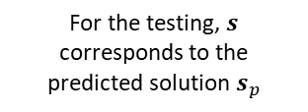










Dimensionality Reduction
$$s=\left[\begin{aligned}s_{1}, \\ s_{2}, \\ …, \\ s_{N_{h}}\end{aligned}\right]$$
$$N_{h}$$
Replace the high-dimensional snapshots with the projection coefficients.
$$w_{L}=V_{L}^{T} s$$
For the training,$s$ corresponds to the high-fidelity solution $s_{hf}$
INPUT
OUTPUT
$$μ=\left[\begin{aligned}g, \\ m, \\ b, \\ f\end{aligned}\right]$$
$$w=\left[\begin{aligned}w_{1}, \\ w_{2}, \\ …, \\ w_{L}\end{aligned}\right]$$
$$L$$
SURROGATE MODEL: $M$
$${s=V_{L} w}_{L}$$
For the testing,$s$ corresponds to the predicted solution$s_{p}$
$$s=\left[\begin{aligned}s_{1}, \\ s_{2}, \\ …, \\ s_{N_{h}}\end{aligned}\right]$$
$$N_{h}$$

Slide 37
Offline Stage
DATABASE OF GEOMETRIES
PCA
PRINCIPAL COEFFICIENTS
STATISTICAL PARAMETERS
SURROGATE MODEL
MACHINE LEARNING
REDUCED SOLUTIONS
OTHER PARAMETERS
PRINCIPAL COEFFICIENTS
POD
HIGH-FIDELITY SOLVER
DATABASE OF SOLUTIONS

Slide 38
Online Stage
NEW GEOMETRY
PCA
PRINCIPAL COMPONENTS
STATISTICAL PARAMETERS
SURROGATE MODEL
MACHINE LEARNING
REDUCED SOLUTION
OTHER PARAMETERS
PRINCIPAL COMPONENTS
POD
HIGH-FIDELITY SOLVER
HIGH-FIDELITY SOLUTION
ERROR
PREDICTED SOLUTION

Slide 39

Take-home Messages
Anatomical structures are very complex, needing a very fine discretization.
Biomechanical problems are very complex and they come with a very high computational cost.
Clinical datasets typically comprise a small number of cases.
Statistical shape modelling enable to compute an accurate but simplified representation of anatomical structures.
Reduced order modelling enable to reduce the computional cost of high-fidelity simulations while preserving their essential dynamics and accuracy.
Statistical shape modelling enable to augment clinical datasets by computing new cases that resemble the original geometrical variability.
Can be used as input.

Slide 40
https://shorturl.at/PqBZW
https://github.com/bisighinibeatrice/NotebookROM

